Slide 1

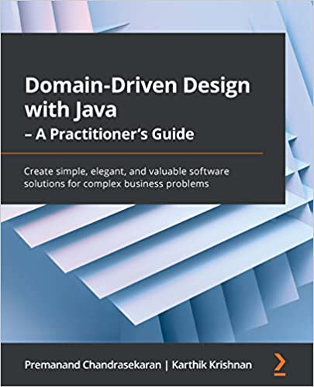
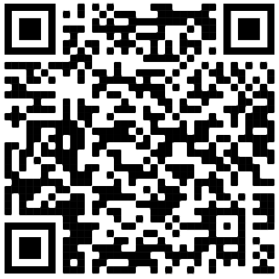

Domain-Driven Design
Part 2
Premanand Chandrasekaran
Karthik Krishnan
Zichuan Xiong

Slide 2
Before the break…
Subdomains
Bounded Contexts
Strategic Design
WHAT
DDD
WHY
DDD
WHAT
Context Maps
Strategic Design
Strategic Design
HOW
Domain Discovery
DDD
HOW
Entities
Tactical Design
WHAT
Value Objects
Tactical Design
Aggregates
Tactical Design
HOW
BDD, TDD
Contract Testing

Slide 3
In this session…
Subdomains
Bounded Contexts
Strategic Design
WHAT
DDD
WHY
DDD
WHAT
Context Maps
Strategic Design
Strategic Design
HOW
Domain Discovery
DDD
HOW
Entities
Tactical Design
WHAT
Value Objects
Tactical Design
Aggregates
Tactical Design
HOW
BDD, TDD
Contract Testing

Slide 4
Bounded Contexts
Independent != Isolated
Credit Cards
Retail Banking
Customer Maintenance
Loans

Slide 5
Bounded Context Relationships
Integrating bounded contexts
A
B
A
Or
B
B
A
Symmetric
Asymmetric

Slide 6
Communication patterns
Symmetric
Asymmetric
A
X
B
A
U
D
OHS
B
PL
Separate Ways
Open Host Service
Published Language
A
B
A
U
D
ACL
B
Shared Kernel
Anti Corruption Layer
A
B
A
U
D
CF
B
Partnership
Conformist

Slide 7
Quiz

Slide 8
Scenario 1
Core
Generic
Shared Kernel
Notes:
Shared Kernel between Core & Generic
This is a strong warning sign. How can something which is unique and key to your company success be coupled to something generic like CRM or payments?
Most of the other patterns could be justifiable here, but the Shared Kernel not so much.

Slide 9
Scenario 2
External System
U
Core
D
CF
Notes:
Core Domain conforms to External System
Core domains are parts of the system where the payback on innovation is greatest. A conformist may constrain your ability to innovate or slow you down.
Removing the dependency or using an ACL could be better alternatives.

Slide 10
Scenario 3
B
U
A
D
CF
CF
D
U
c
D
D
CF
U
Notes:
Chain of Conformists
Conformist implies a high chance of co-change - when one model changes, other contexts must also change.
With a chain of conformists, a change to the model in one context can result in many other contexts also needing to change.
ACLs might be a better pattern, but also the design may be fundamentally flawed if so many contexts are all coupled to the same model. The boundaries may be wrong.

Slide 11
Scenario 4
External System
U
Generic
D
ACL
Notes:
Generic Context ACL for External System
This one is not clear cut. There are a few considerations: how much does it cost to build and maintain the ACL? And what is the future of the generic context - is there a chance it could be fully replaced with an off-the-shelf solution.
Answer those questions as a starting point.

Slide 12
Scenario 5
U
B
D
A
Supplier
Customer
U
D
Customer
D
c
D
Customer
Notes:
In-Demand Supplier
This pattern is definitely a warning sign that things could get out of control and political. If each customer has urgent needs and the supplier does not have the capacity to meet all of their requirements, the supplier has effectively become a bottleneck.
Each customer will not be able to achieve their goals without the supplier, so they will exert maximum pressure on the supplier and it may spiral out of control.

Slide 13
Scenario 6
B
B
Partnership
Partnership
A
B
B
Partnership
Partnership
Notes:
Friendly Octopus
A partnership is a high maintenance relationship. It requires teams to spend significant amounts of time together planning, designing, and developing a solution.
When a context has multiple partnerships, the team may spend all of it's time collaborating and have little capacity for delivery.
In a scenario like this, the entire sociotechnical architecture needs to be reviewed.

Slide 14
Scenario 7
U
B
A
OHS
D
U
U
D
c
D
D
Notes:
High Utilization Open Host
This one could be really good or really bad.
The key thing to establish is how much the OHS is customised to specific consumers.
If the OHS is used by all clients in the same way. It's a sign of a good abstraction and the high-level of reusage represents good economies of scale.
If the OHS has lots of minor modifications for each consumer. It will probably become confusing and messy for all of them, and will be harder to maintain.

Slide 15
Recap: Communication patterns
Symmetric
Asymmetric
A
X
B
A
U
D
OHS
B
PL
Separate Ways
Open Host Service
Published Language
A
B
A
U
D
ACL
B
Shared Kernel
Anti Corruption Layer
A
B
A
U
D
CF
B
Partnership
Conformist

Slide 16
Separate ways
No relationships between two bounded contexts
A
B
X
Implications
Common functionality will have to be duplicated
May become cost prohibitive
When to use
Teams are unwilling/unable to collaborate
Maximum independence is desired
© 2021 Thoughtworks
Notes:
The separate ways pattern should be avoided when integrating core subdomains. Duplicating the implementation of such subdomains would defy the company’s strategy to implement them in the most effective and optimized way.

Slide 17
Shared Kernel
Clear boundaries with a low collaboration cost
A
B
Shared Kernel
Implications
Cooperating teams share the same model or parts of it
Changes made to shared kernel affect participating teams
When to use
Cost of duplication is higher than the cost of coordination
Shared models change infrequently
© 2021 Thoughtworks
Notes:
It’s crucial to stress that the shared model is designed according to the needs of all of the bounded contexts. Moreover, the shared model has to be consistent across all of the bounded contexts that are using it.
Both participating teams can modify the shared kernel, as long as they keep it compatible

Slide 18
Partnership
Bounded contexts are integrated in an ad hoc manner
A
B
Implications
Integration is two-way
High degrees of collaboration needed to reduce integration delays
When to use
Teams are co-located
High levels of trust exist between coordinating teams
Avoid when possible
“Big ball of mud”
© 2021 Thoughtworks
Notes:
In the partnership model, the integration between bounded contexts is coordinated in an ad hoc manner. One team can notify a second team about a change in the API, and the second team will cooperate and adapt—no drama or conflicts.

Slide 19
Open-Host Service
Supplier wants to provide a good experience for all its customers
Supplier
Customer
U
D
OHS
PL
Implications
Supplier has strong motivation to protect consumers from its internals
Supplier provides service using a well known “Published Language”
When to use
Supplier needs to support multiple customers
Supplier internals may need to change frequently
© 2021 Thoughtworks
Notes:
The supplier’s public interface is not intended to conform to its ubiquitous language. Instead, it is intended to expose a protocol convenient for the consumers, expressed in an integration-oriented language. As such, the public protocol is called the published language.
In a sense, the open-host service pattern is a reversal of the anticorruption layer pattern: instead of the consumer, the supplier implements the translation of its internal model.

Slide 20
Anti-Corruption Layer
Customer wants to protect itself from supplier models
Supplier
Customer
U
D
ACL
Implications
Supplier has little motivation to support customer needs
Customer is unwilling to conform
When to use
Customer is a core domain
Upstream model is inefficient
Supplier’s contract changes often
© 2021 Thoughtworks

Slide 21
Conformist
Customer accepts dependency on supplier model
Supplier
Customer
U
D
Conforms
Implications
Supplier has little motivation to support customer needs
Customer is in a “take it or leave it” situation
When to use
Supplier model may be good enough
Supplier model is a well-known, accepted, de facto standard
Team does not have the skills
© 2021 Thoughtworks
Notes:
In some cases, the balance of power favors the upstream team, which has no real motivation to support its clients’ needs. Instead, it just provides the integration contract, defined according to its own model—take it or leave it. Such power imbalances can be caused by integration with service providers that are external to the organization or simply by organizational politics.

Slide 22
Customer-Supplier
Consumer-driven contracts
Service
Provider
Service Consumer
U
D
Implications
Customer is seemingly in control
No changes without consulting with the customer
May become burdensome for the producer
When to use
Always? Most of the time?
Especially when working with “internal” service providers
© 2021 Thoughtworks
Notes:
Consumer-driven contracts: https://martinfowler.com/articles/consumerDrivenContracts.html
:

Slide 23
Bounded Context Relationship Heuristic
Yes
Yes
Yes
Shared Kernel
Is there a symmetric relationship?
Is the duplication cost higher than collaboration cost?
Are the boundaries between models clear?
No
No
No
Separate Ways
Partnership
Yes
Yes
Anti-corruption Layer
Is supplier less motivated in supporting customer?
Does customer need protect from supplier?
No
No
Open-host Service
Conformist

Slide 24

Bringing it all together
Let’s apply what we have learnt in this series of questions

Slide 25
Bringing it all together
Retail Banking
Credit Cards
CF
ACL
CF
ACL
Customer Maintenance
OHS
Loans
CF
XYZ Bank
Notes:
Q1: Let’s say, Credit Cards is dependant on the Retail Accounts, maybe because customers can set up direct payments from their retail accounts to their credit cards. Let’s say that the credit cards team is willing to accept the APIs provided by the retail accounts team - as is. What kind of a relationship does the credit cards bounded context have with the retail accounts bounded context?
Answer: The credit cards team acts as a conformist with the retail accounts team because they are willing to accept the models provided by the retail accounts team as is.
Q2: Similarly, the loans team wants to allow customers to make direct payments APIs from their retail accounts. But the loans team does not want to treat this ability as a special one. They want to allow payments from other banks just as well. What kind of relationship would exist between loans and retail accounts?
Answer: The loans teams needs to implement an anti-corruption layer between itself and the retail accounts team.
Q3: Next question has two parts: 1. The customer maintenance team is exposing a common set of services. 2. Retail accounts wants to use these services, but is again concerned about using those models directly. How can these two bounded contexts integrate?
Answer: The customer maintenance team should provide an open host service using a published language and the retail banking team should use an ACL to integrate.
Q4: Loans and credit card teams are willing to use the services provided by the customer maintenance team as is. How should they integrate?
Answer: Using the conformist pattern.

Slide 26
Congrats! We created our first context map!
U
D
Credit Cards
Retail Banking
CF
ACL
CF
U
D
D
D
ACL
Customer Maintenance
OHS
Loans
U
CF
D
XYZ Bank

Slide 27
Create your first context map
ACL
CF
CF
ACL
CF
D
???
???
OHS
U
D
OHS
D
D
????
subdomain
U
D
Domain
ACL
CF
CF
OHS
ACL
CF
OHS

Slide 28
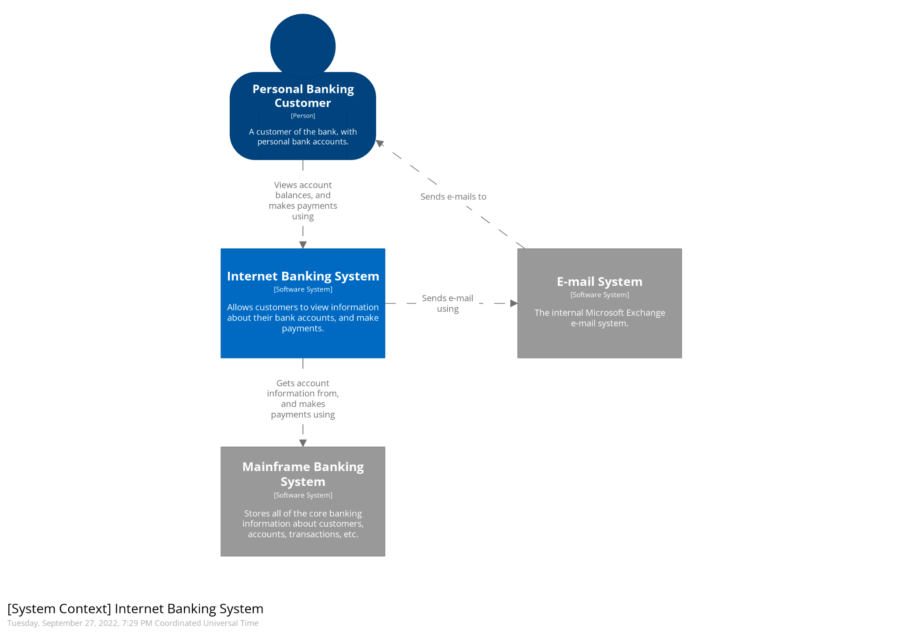
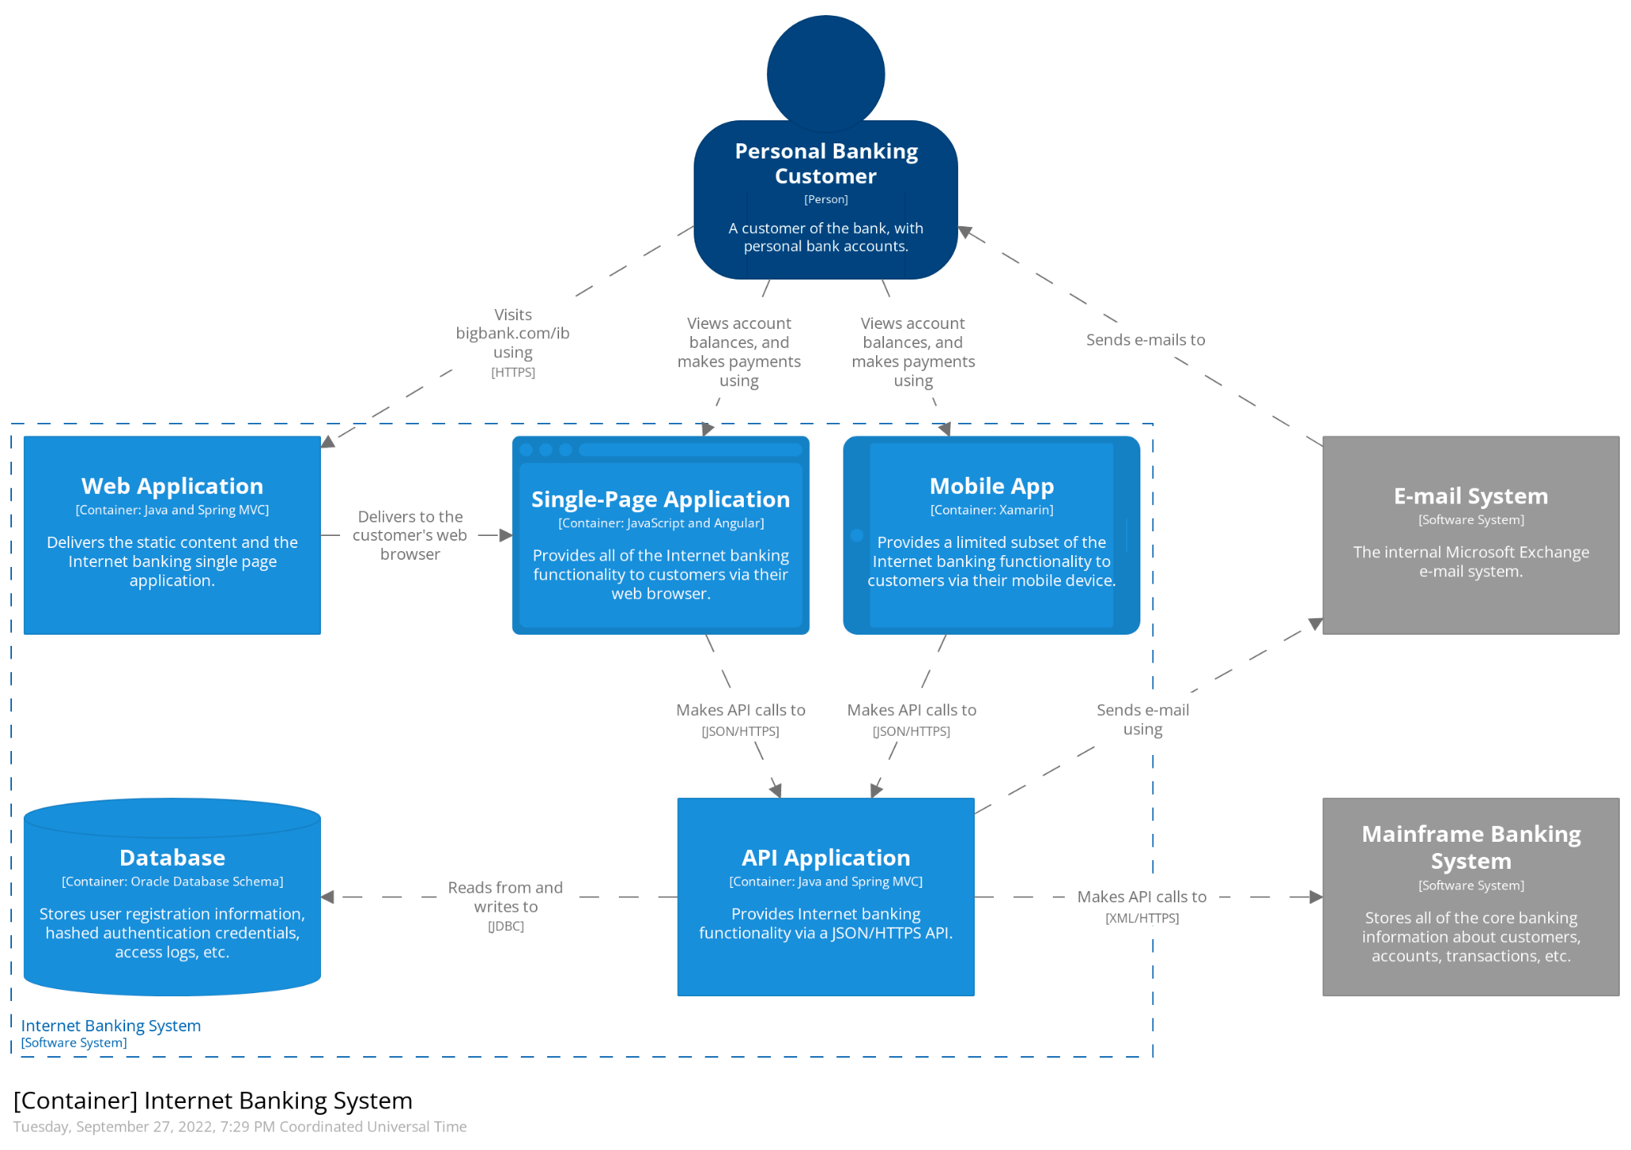
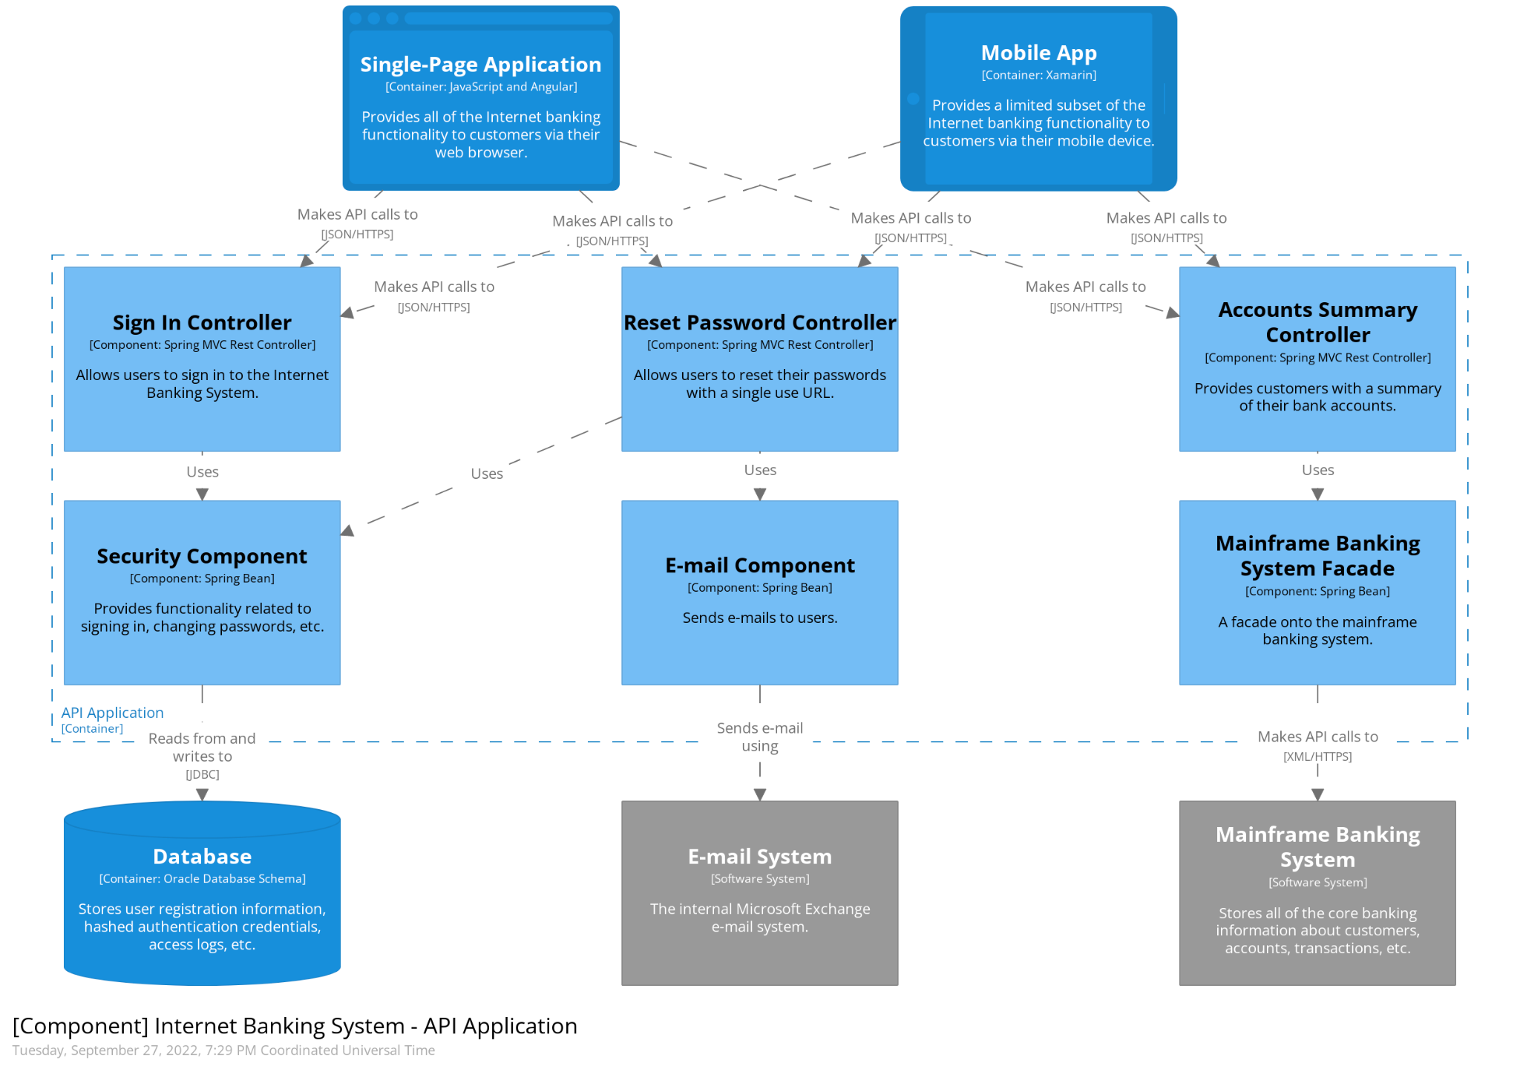
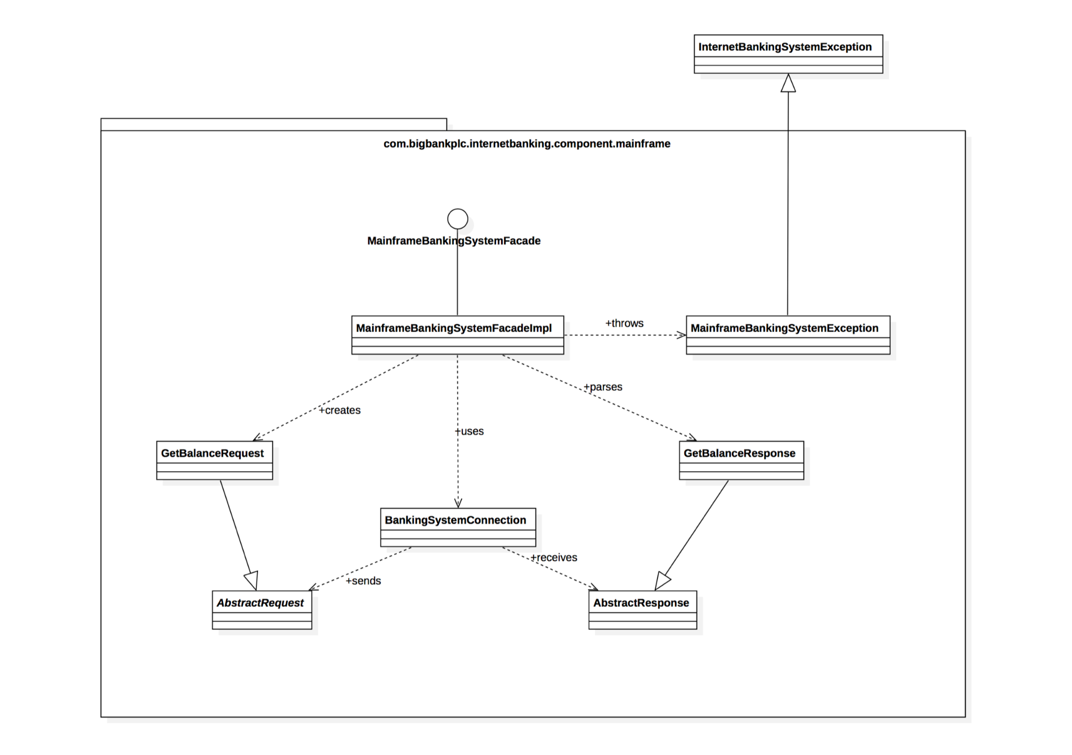
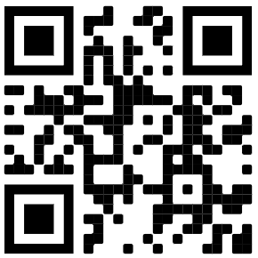
Parallels with the C4 model
Context
Containers
Components
Code
https://c4model.com/

Slide 29
The Context Level
A good starting point for diagramming and documenting a software system, allowing you to step back and see the big picture

Slide 30

Homework
Create a context map for your own (sub)-domain and share

Slide 31
Recap
Subdomains
✔
✔
Bounded Contexts
✔
✔
✔
Strategic Design
WHAT
DDD
WHY
DDD
WHAT
✔
Context Maps
✔
Strategic Design
Strategic Design
HOW
Domain Discovery
DDD
HOW
Entities
Tactical Design
WHAT
Value Objects
Tactical Design
Aggregates
Tactical Design
HOW
BDD
TDD

Slide 32

Domain-Driven Design
How to practice DDD?
Strategic
DDD
HOW

Slide 33
Let’s discover the domain visually, collaboratively, and iteratively
Spreading domain knowledge
Creating a shared understanding
Providing a framework of distributing knowledge
Notes:
Domain Discovery is not only about identifying the domains that need to focus on, it’s essentially about building the consensus between the problem and solution spaces, and managing a set of ubiquitous language that drives a shared understanding. Domain discovery can be at different levels, and there are different techniques to do that

Slide 34
From Agile to DDD
Business Architecture
Platform Strategy
DDD
EventStorming
Product Strategy
Domain Services
Strategic
Lean Startup Machine
Service Design
MVP
Lean
Design Thinking
Prototype
Customer Journey
Kanban
Service Code
Epic Story
UAT
AC
Tactical
User Story
Sprint
Agile
Function Code
Focusing on Problem Domain
Focusing on Solution Domain

Slide 35
All kinds of Domain Discovery activities
DDD
DDD
3 hr +
Wardley Mapping
EventStorming
High Effort
DDD
Lean
Agile
2 hr
Domain Storytelling
Lean Canvas
User Story Mapping
Lean
Lean
Agile
1 hr
Impact Mapping
Business Model Canvas
User Journey Mapping
Low Effort
Agile
Agile
30 min
Elevator Pitch
Example Mapping
Focusing on Problem Domain
Focusing on Solution Domain

Slide 36
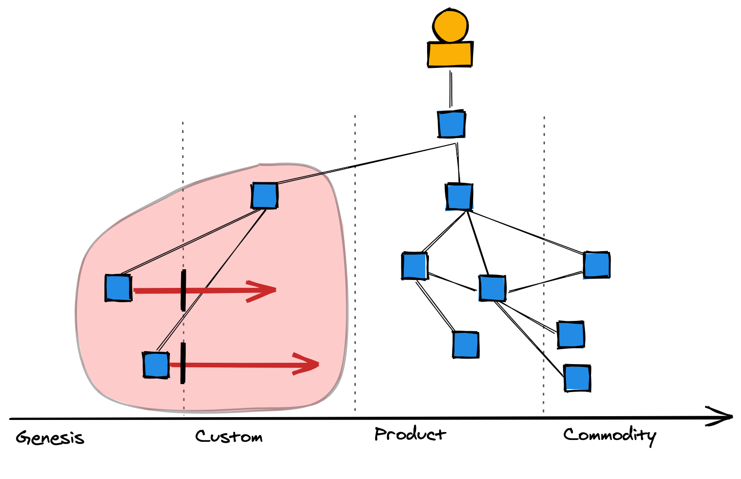
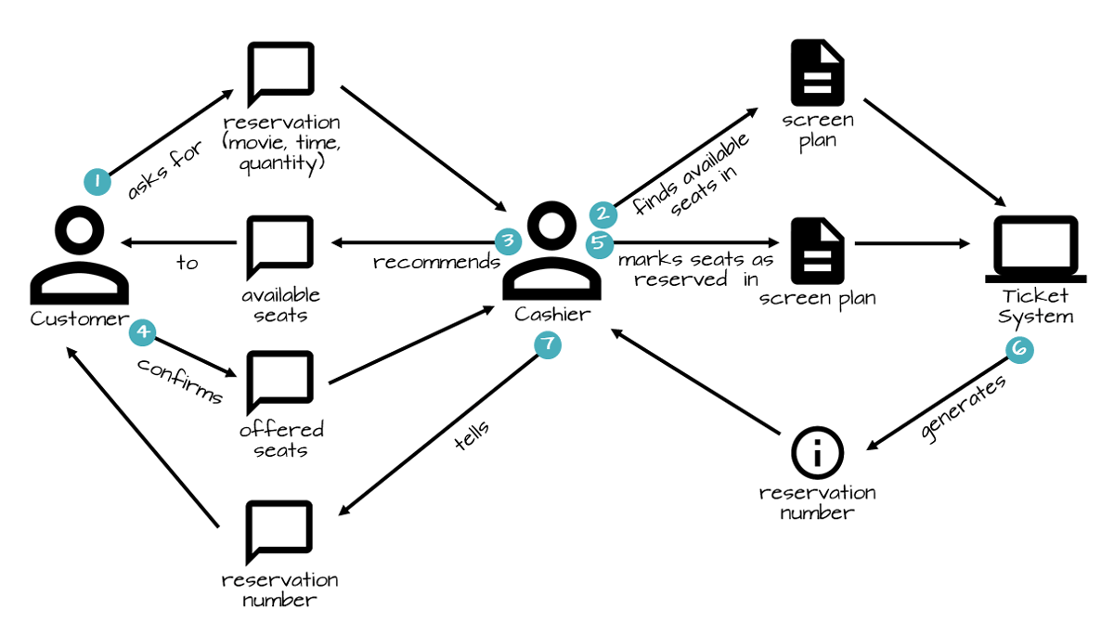

Key Domain Discovery activities
Wardley Mapping
Domain Storytelling
Event Storming - Strategic Design

Slide 37
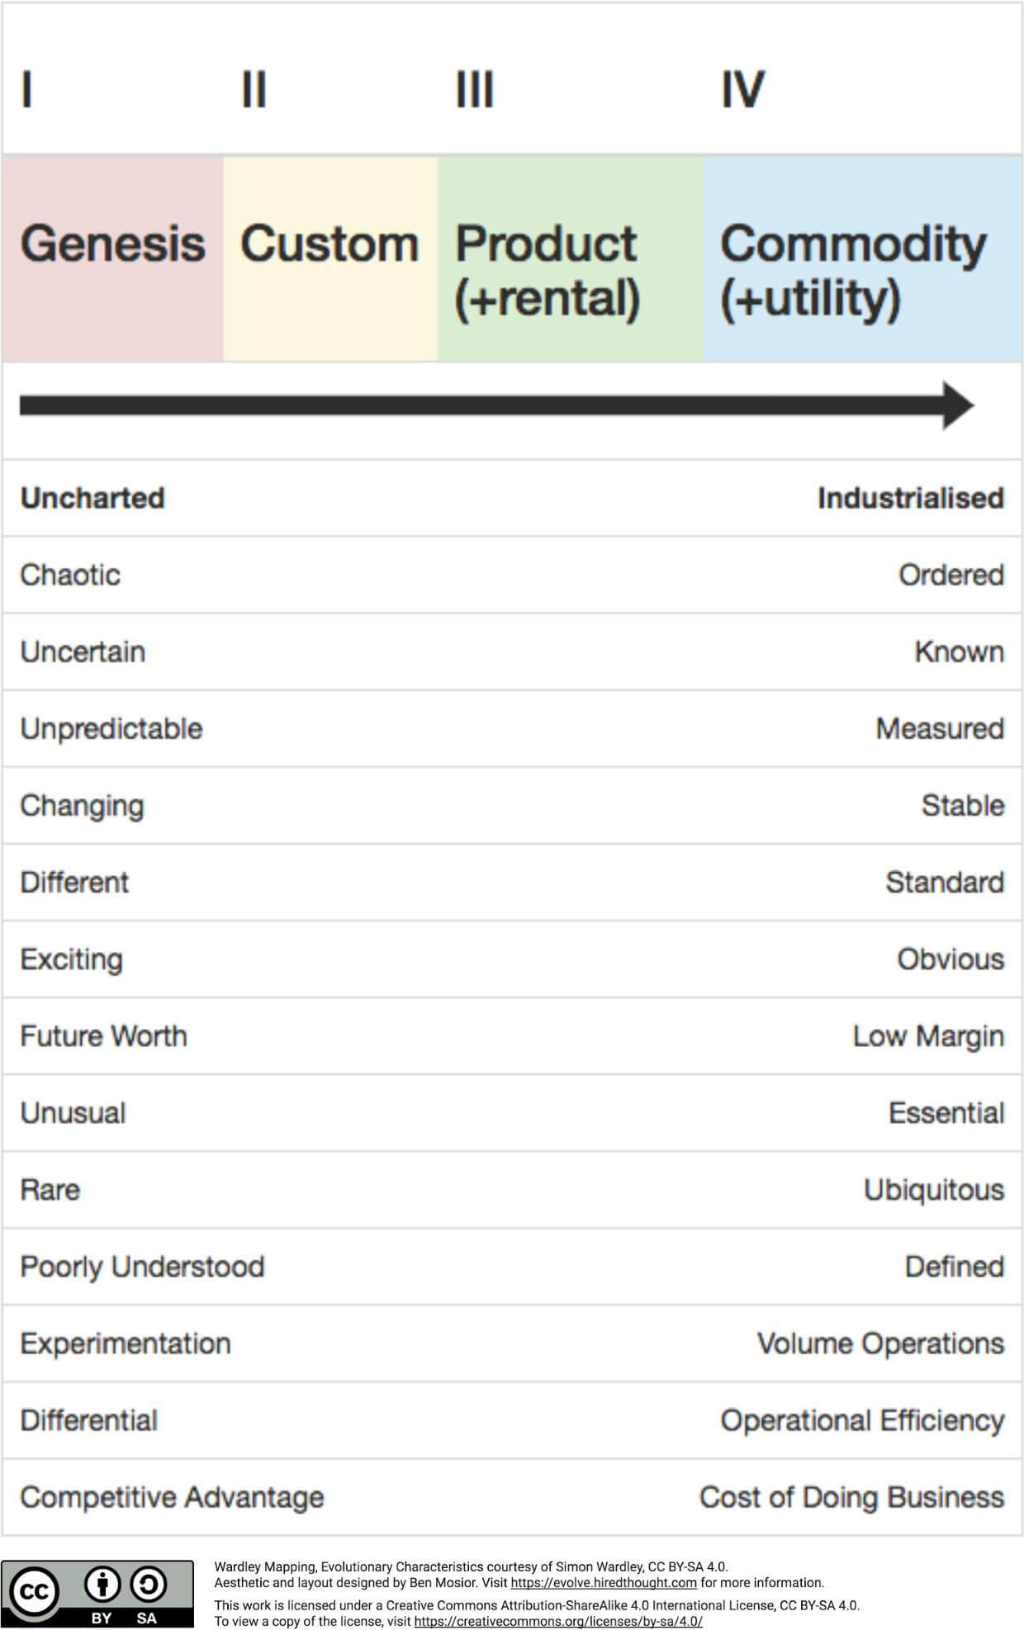
Scoping for the right domains to discover more through Wardley Mapping

Slide 38
Scoping for the right domains to discover more through Wardley Mapping
Core
Supporting
Generic
Genesis
Custom
Product (+rental)
Commodity (+utility)

Slide 39
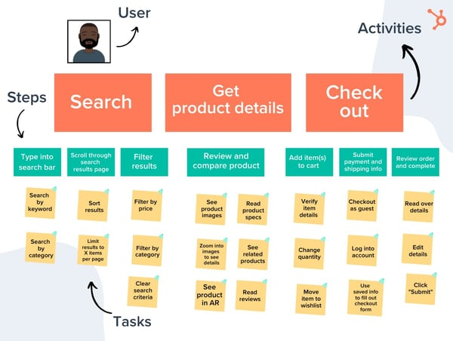
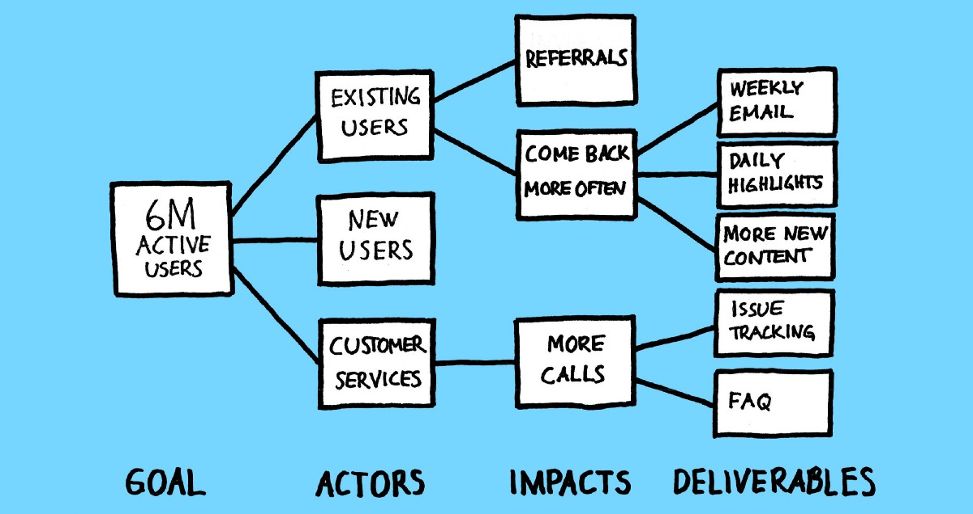
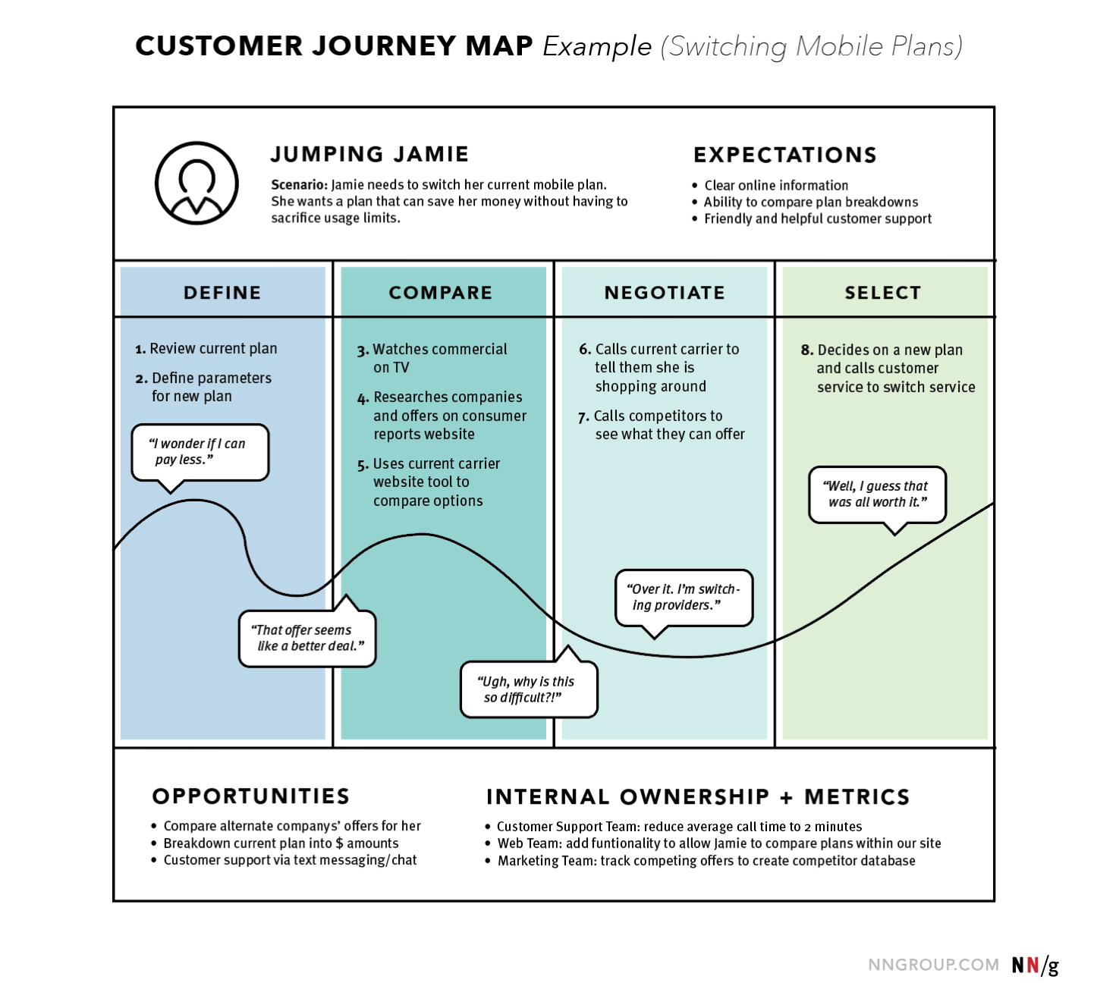
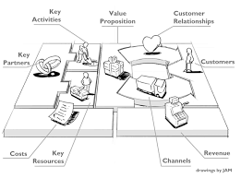
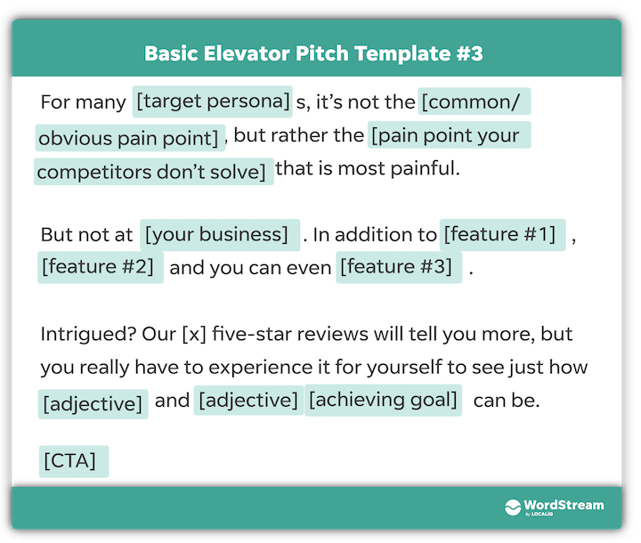
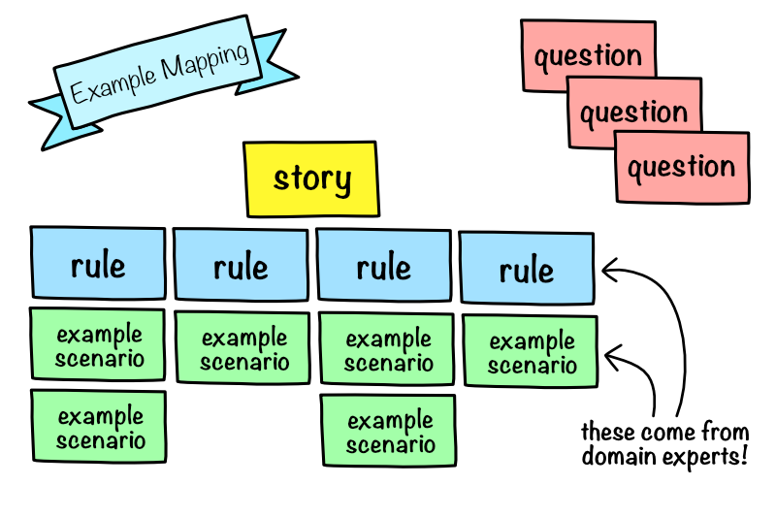
Discovery techniques and their relationships
Business-level Discovery Techniques
Domain-level Discovery Techniques
Story-level Discovery Techniques
Provides domain categorization (core / support / generic)
Wardley Map
Provides business & competitive context
Event Storming (Strategic Design)
Provides customer context
Provides prioritized domains
Use Story Mapping
Provides essential business flows / value chains
Provides context for user story breakdown
Domain Storytelling
Impact Mapping
Customer Journey Map
Provides story-level domain context
Business/Lean Model Canvas
Provides customer context
Elevator Pitch
Provides business & competitive context
Example Mapping

Slide 40


Lunch!

